Slide 1
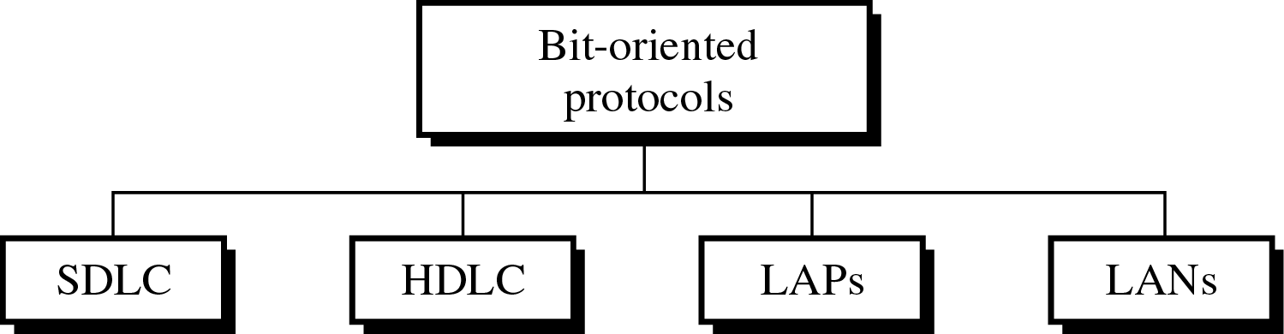
CS601-Data Communication
VU
LECTURE #41
Bit-Oriented Protocols
In character-oriented protocols, bits are grouped into predefined patterns forming characters
By comparison, bit-oriented protocols can pack more information into shorter frames
A lot of bit-oriented protocols have been developed over the years:
One of these HDLC is the design of the ISO and has become the basis for all bit- oriented protocols in use today
•In 1975, IBM gave Synchronous Data Link Control (SDLC)
•In 1979, ISO answered with High Level Data Link Control (HDLC)
Since 1981, ITU-T has developed a series of protocols called Link Access Protocols
LAPs: LAPB, LAPD, LAPM, LAPZ etc. all based on HDLC
HDLC is basis for all protocols, so we will study it in detail:
High Level Data Link Control (HDLC)
Bit-oriented data link protocol designed for:
Full Duplex and Half Duplex
Point-to-point And Multipoint Links
Characterization of HDLC
HDLC can be characterized by:
–Station Types
–Configurations
–Response Modes
STATION TYPES (1)
HDLC differentiates b/w 3 types of stations:
– Primary Station
210

Slide 2
CS601-Data Communication
VU
Secondary Station
Combined Station
STATION TYPES (2)
Primary Station
Primary station works in the same way as primary devices in the discussion of flow control
The primary is a device in point-to-point or multipoint line configuration that has complete control of the link
STATION TYPES (3)
Secondary Station
The primary sends commands to the secondary stations
A primary issues commands and a secondary issues responses
STATION TYPES (4)
Combined Station
A combined station can both command and respond
A combined station is one of a set of connected peer devices programmed to behave either as a primary or as a secondary depending on the nature and the direction of the transmission
Configuration (1)
Configuration refers to the relationship of the hardware devices on a link
Primary , secondary and combined stations can be configured in three ways:
Unbalanced Configuration
Symmetrical Configuration
Balanced Configuration
Configuration (2)
Unbalanced Configuration
Also called Master/Slave Configuration
One device is a primary and others are secondary
Unbalanced configuration can be point to point if only two devices are involved
Most of the times it is multipoint with one primary controlling several secondaries
Configuration (3)
Symmetrical Configuration
Each physical station on a link consists of two logical stations, one a primary and the other a secondary
Separate lines link the primary aspect of one physical station to the secondary aspect of another physical station

Slide 3
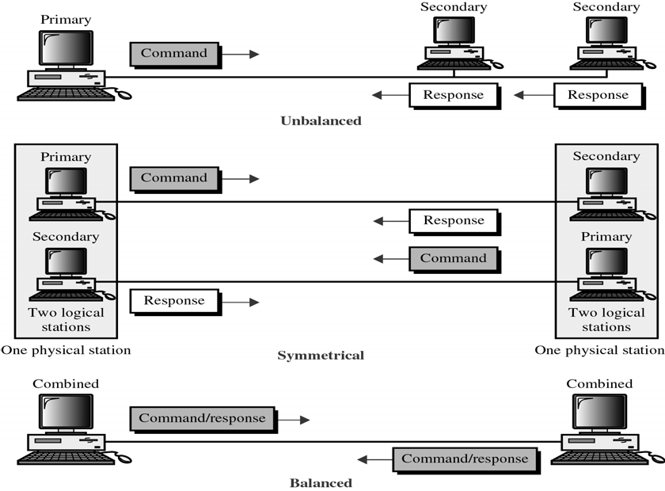
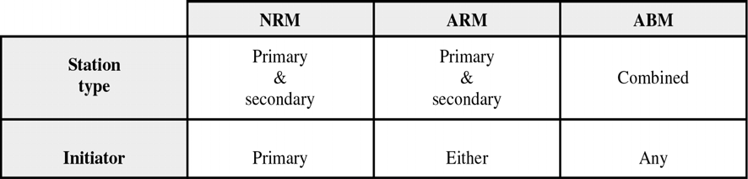
CS601-Data Communication
VU
Configuration (4)
Balanced Configuration
Both stations in a point-to-point topology are of combined type
HDLC does not support balanced multipoint
Station Types & Configurations
Modes
A mode in HDLC is the relationship b/w two devices involved in an exchange
The mode describes who controls the link
HDLC supports 3 modes of communication b/w stations:
–Normal Response Mode (NRM)
–Asynchronous Response Mode (ARM)
–Asynchronous Balanced Mode (ABM)
Normal Response Mode (NRM)
Refers to the standard primary-secondary relationship
Secondary device must have permission from primary device before transmitting
Once permission has been granted, the secondary may initiate a response transmission of one or more frames containing data

Slide 4
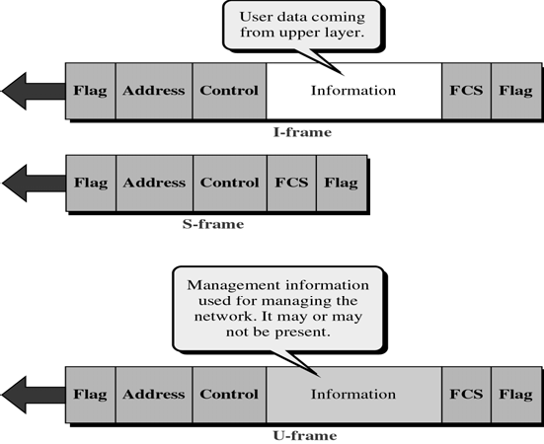
CS601-Data Communication
VU
Asynchronous Response Mode (ARM)
A secondary may initiate a TX w/o permission from the primary whenever the channel is idle
ARM does not alter the primary secondary relationship in any other way
All transmissions from the primary still go to the secondary and are then relayed to the other devices
Asynchronous Balanced Mode (ABM)
All stations are equal and therefore only combined stations connected in point-to- point are used
o Either combined permission
HDLC Frames
station may initiate TX with the other combined station w/o
HDLC defines 3 types of Frames:
Information Frames (I-Frames)
Supervisory Frames (S-Frames)
Unnumbered Frames(U-Frames)
I-Frames are used to transport user data and control information relating to user data
S-Frames are used only to transport control information
U-Frame are reserved for System Management
Each frame in HDLC may contain up to six fields
–A beginning Flag Field
–An address field
–A control field
–An information Field
–A frame check sequence (FCS)
–An ending Flag Field

Slide 5
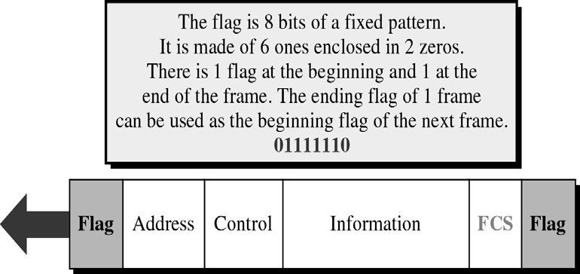
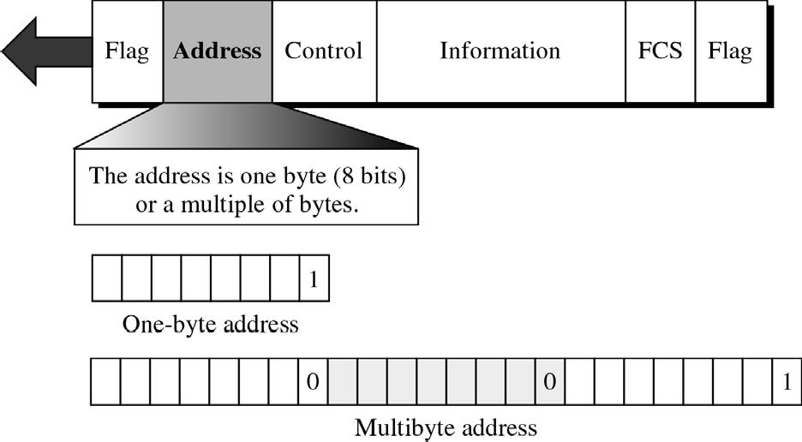
CS601-Data Communication
VU
Flag Field
•The flag field of an HDLC frame is an 8-bit sequence with a bit patter 01111110 that identifies both the beginning and the ending of the of a frame
•It serves as a Synchronization pattern for the receiver
•Fig. shows placement of 2 flag fields in an I-Frame
HDLC Address Field
o
The second field of HDLC frame contains the address of the secondary station that is either the originator or the destination of the frame
If a primary station creates Frame it includes a ‘To’ address and if a secondary creates the frame, it contains a ‘From’ address
Can be of one byte or several bytes depending upon the network
If the address field is only 1 byte, the last bit is always a 1
If the address is of several bytes, all bytes but the last one will end with 0 , and the last will end with a 1
Ending each intermediate byte with 0 indicates to the receiver that there are more address bytes to come

Slide 6
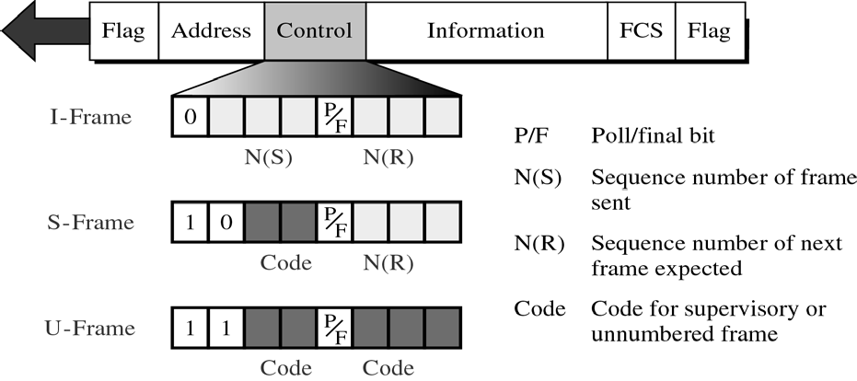
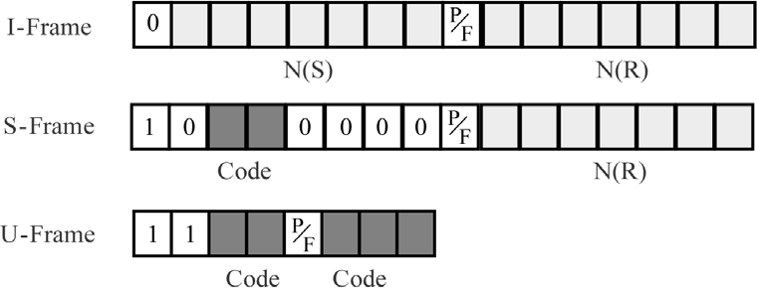
CS601-Data Communication
VU
HDLC Control Field
The control field is a one o two byte segment of the frame used for flow management
The two byte case is called the Extended Mode
Control fields differ depending on the frame type:
If the control field is a 0, the frame is an I-Frame
If the first bit is 1 and the second bit is a 0 , it is S-Frame
If both first and second bits are 1’s, it is U-Frame
P/F bit is a single bit with dual purpose
It has meaning only when it is ‘1’ and it can mean Poll or Final
When the frame is sent by a primary to secondary, it means POLL
When the frame is sent by a secondary to a primary, it is FINAL
HDLC Control Field –EXTENDED
Control field in the I-Frame and S-Frame is two bytes long to allow seven bits of sending and receiving sequence
However the control field in the U-Frame is still one byte

Slide 7
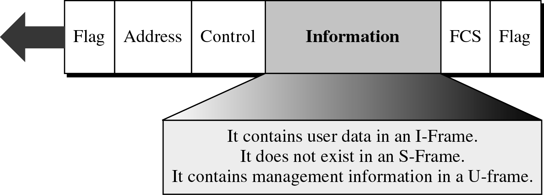
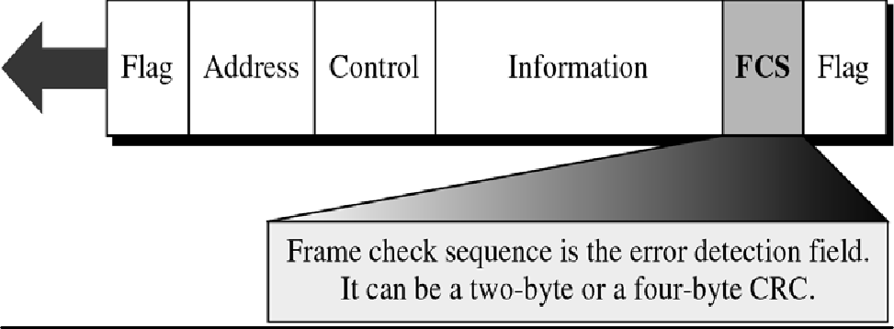
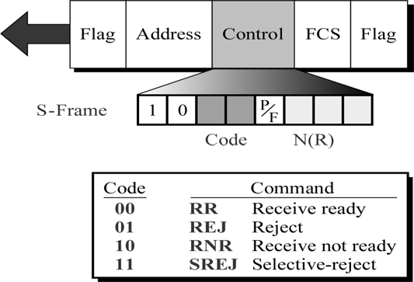
CS601-Data Communication
VU
Information field contains the user’s data in an I-Frame and Network Management information in a U-Frame
An S-Frame has no information field
Its length can vary from one network to another but remains fixed within each network
It is possible to send Control information in the information field of the I-Frame along with data.
This process is called Piggybacking
o The FCS is HDLC’s error detection field
o o
It can contain a two- or four byte CRC

Slide 8
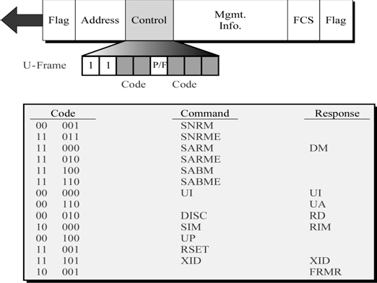
CS601-Data Communication
VU
Link Access Procedures
LAPB
–Link access procedure, balanced
LAPD
–Link access procedure for D- channel
LAPM
–Link access procedure for modems
Summary
*Synchronous Protocols
–Bit-Oriented Protocols
•HDLC
*Link Access Protocols (LAPs)
Reading Sections
*Section11.4, 11.5
“Data Communications and Networking” 4th Edition by Behrouz A. Forouzan

Slide 9
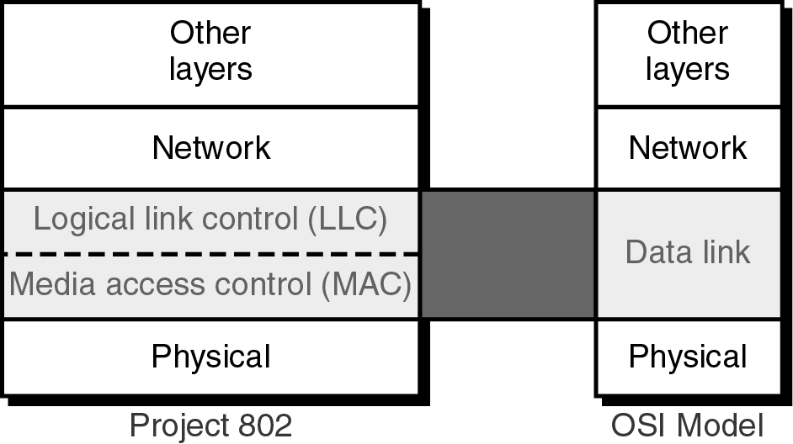
CS601-Data Communication
VU
LECTURE #42
Local Area Network
A local area network is a data communication system that allows a number of independent devices to communicate directly with each other in a limited geographical area
Architectures for LANS
Dominated by 4 architectures:
Ethernet, Token Bus, Token Ring € Standards of IEEE and a part of its Project 802
Fiber Distributed Data Interface (FDDI) € ANSI Standard
LAN compared with OSI
In 1985, the computer society of IEEE started a project called PROJECT 802 to set standards to enable intercommunication b/w equipment from a variety of manufacturers
This project does not seek to replace any part of the OSI Model
Instead it is a way of specifying functions of physical layer , the data link layer and up to some extent the network layer to allow for interconnectivity of major LAN protocols
The relationship of IEEE project 802 to the OSI Model is shown in the figure:
•
FIGURE
IEEE has divided the data link layer into two sub-layers:
Logical Link Control (LLC) Medium Access Control (MAC)
LLC is non-architecture specific i.e. it is the same for all IEEE-defined LANs
The MAC sub layer on the other hand contains a number of distinct modules; each carries proprietary info specific to the LAN product being used
LAN compared with OSI -Figure

Slide 10
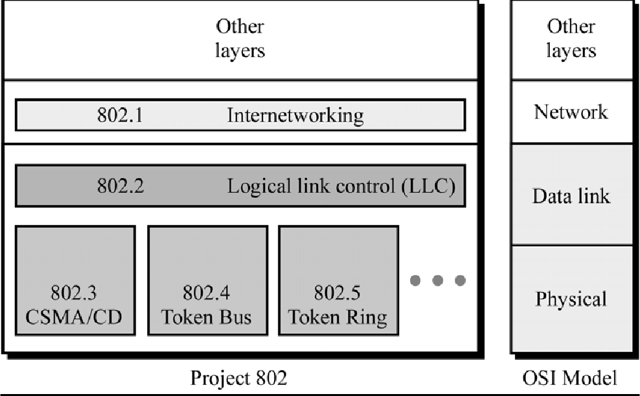
CS601-Data Communication VU
In addition to the two sub-layers , Project 802 contain a section governing internetworking
This section assures the compatibility of different LANs and MANs across protocols and allows data to be exchanged across otherwise incompatible networks
PROJECT 802
Strength of Project 802 is Modularity
By subdividing the functions necessary for LAN management, the designers were able to standardize those that can be generalized and isolate those that must remain specific
•
➢ IEEE 802.11
Is the section of Project 802 devoted to internetworking issues in LANs and MANs
Although not yet complete, it seek to resolve the incompatibilities b/w network architectures w/o requiring modifications in existing addressing, access, and error recovery mechanisms
LLC
In general, IEEE project 802 model takes the structure of an HDLC frame and divides into two sets of functions:
One set contains the end-user portions of the frame: The logical address, control information and data
These functions are handled by IEEE 802.2 LLC protocol
LLC is upper of data link layer and is common to all LAN protocols
MAC
The second set of functions, the MAC sub-layer , resolves the contention for the shared media
It contains Synchronization Flag, Flow and Error control specifications as well as the physical address of next station to receive & route a packet

Slide 11
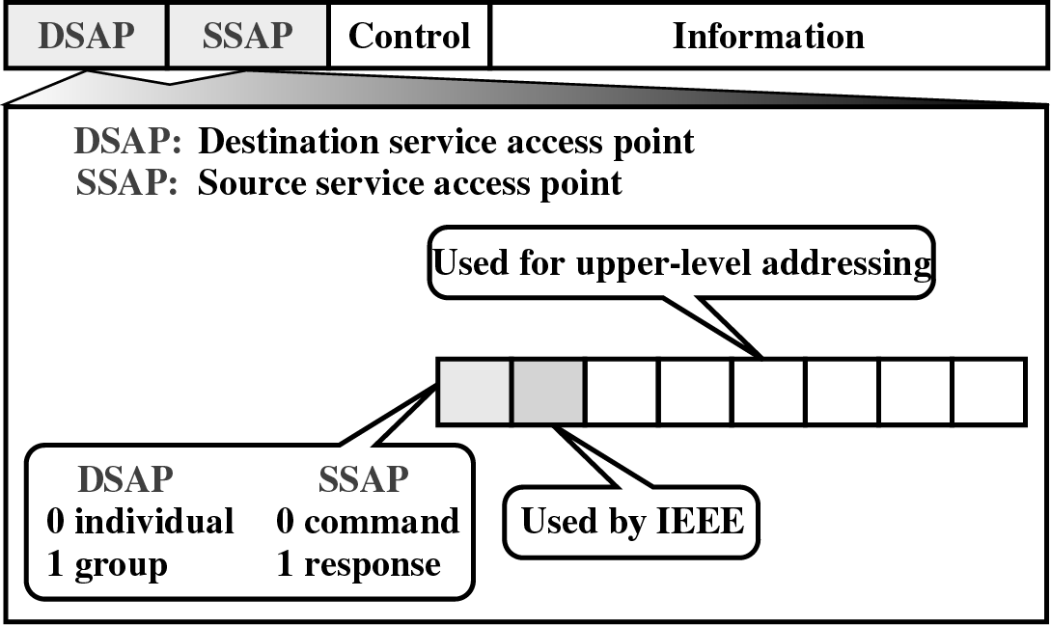
CS601-Data Communication VU
MAC protocols are specific to LAN using them (Ethernet, Token Ring, Token Bus etc)
Protocol Data Unit (PDU)
The data unit in the LLC level is called the Protocol Data unit (PDU)
The PDU contains 4 fields familiar from HDLC:
–A destination service access point (DSAP)
–A source service access point (SSAP)
–A control field
–An Information field
Protocol Data Unit (PDU)
DSAP and SSAP
The DSAP and SSAP are addresses used by LLC to identify the protocol stacks on the receiving and sending machines that are generating and using data
The first bit of the DSAP indicates whether the frame is intended for an individual or a group
The first bit of SSAP indicates whether the communication is a command or a response PDU
CONTROL
The control field of PDU is identical to the control field in HDLC.
As in HDLC, PDU frames can be I-frames, S-frames, or U-Frames and carry all of the codes and the information that the corresponding HDLC frame carry
•The PDU has no flag fields, no CRC, and no station address
•These fields are added in the lower sub-layer i.e. MAC Layer
220

Slide 12
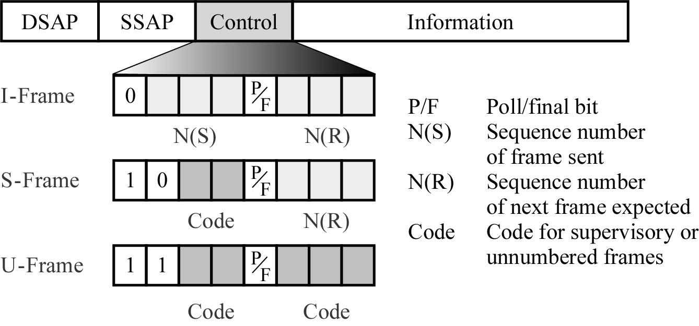
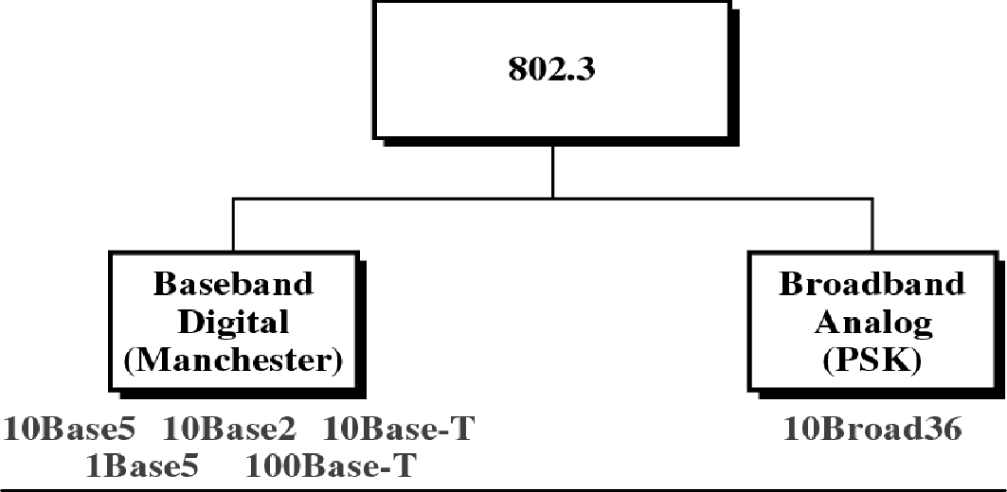
CS601-Data Communication
VU
ETHERNET
IEEE 802.3 supports a LAN standard originally developed by Xerox and later extended by a joint venture b/w Digital Equipment Corporation, Intel Corporation and Xerox
This is called ETHERNET
Categories of 802.3-Figure
•
IEEE 802.3 defines two categories:
–BASEBAND
–BROADBAND
The word “base” specifies a digital signal The word “broad” specifies an analog signal

Slide 13
CS601-Data Communication
VU
IEEE divides the base band category into 5 standards:
–10 Base 5 , 10 Base 2, 10 Base-T, 1 Base 5, 100 Base-T
The first number (10, 1, or 100) indicates the data rate in Mbps.
The last number or letter (5, 2, 1, or T) indicates the maximum cable length or the type of cable
IEEE defines only one specification for the broadband category:
–10 Broad 36
Again the first number (10) indicates the data rate.
The last number defines the maximum cable length
Max. cable length restriction can be changed using networking devices i.e. Repeaters or Bridges
Access Method: CSMA/CD
Multiple Access: Multiple users access to a single line
Carrier Sense: A device listens to the line before it transmits
Collision Detection: Extremely high voltage indicates a collision
Need for a Access Method
Whenever multiple users have unregulated access to a single line, there is a danger of signals overlapping and destroying each other
Such overlaps which turn signals to Noise are called COLLISIONS
As traffic increases on multiple-access link, so do collisions
A LAN therefore needs a mechanism to coordinate traffic, minimize the number of collisions and maximizes the number of frames that are delivered successfully
The access mechanism used in Ethernet is called Carrier Sense Multiple Access with Collision Detection (CSMA/CD)
•MA€ CSMA € CSMA/CD
CSMA/CD
The original design was a multiple access method in which every workstation had equal access to the link
In multiple access, there was no provision for traffic coordination
Access to the line was open to any node at any time
Any device wishing to transmit sent its data and then relied on ACKs to know if it had reached its destination
In a CSMA system, any device wishing to transmit must first listen for existing traffic on the line
A device must listen by checking for voltage
If no voltage is detected, the line is considered idle and the TX is initiated
CSMA cuts down on the number of collisions but does not eliminate them
If a system transmits after checking the line and another system transmits during this small interval, collisions can still occur
The final step is the addition of Collision Detection (CD)
In CSMA/CD, the station wishing to transmit first listens to make certain the link is free, then transmits its data, then listens again

Slide 14
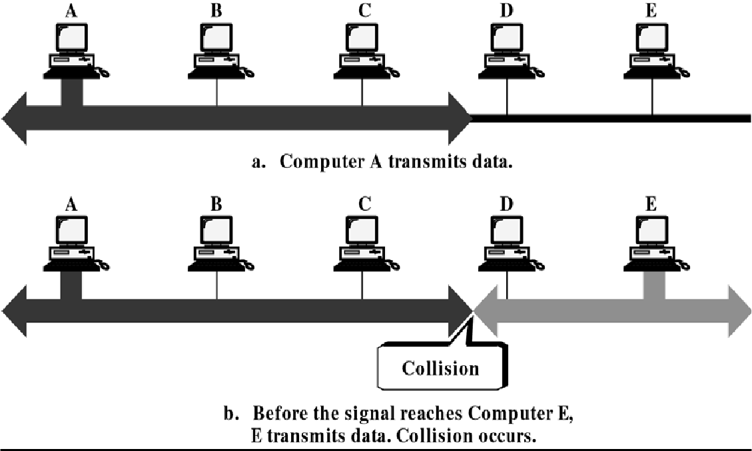
CS601-Data Communication VU
During the data transmission, the station checks for the extremely high voltages that indicate a collision
If a collision is detected, the station quits the current TX and waits a predetermined amount of time for the line to clear, then sends its data again
•
Addressing
Each station on the Ethernet network such as a PC, workstation or printer has its own Network Interface Card (NIC)
The NIC usually fits inside the station and provides the station with a 6-byte physical address
The number on the NIC is unique
Data Rate
Ethernet LANs can support data rates between 1 and 100 Mbps
Implementation
In IEEE 802.3 standard, the IEEE defines types of cables, connections and signals that are to be used in each of the five different Ethernet implementations
Each frame is transmitted to every station on the link but read only by the station to which it is addressed
10 Base 5: Thick Ethernet
The first of the physical standards defined in IEEE 802.3 model is called 10 Base 5,
Thick Ethernet or Thicknet
The name is derived from the size of the cable which is roughly the size of a garden hose and cannot be bent with hands
10 Base 5 is a bus topology LAN that uses base band signaling and has a max. segment length of 500 meters

Slide 15
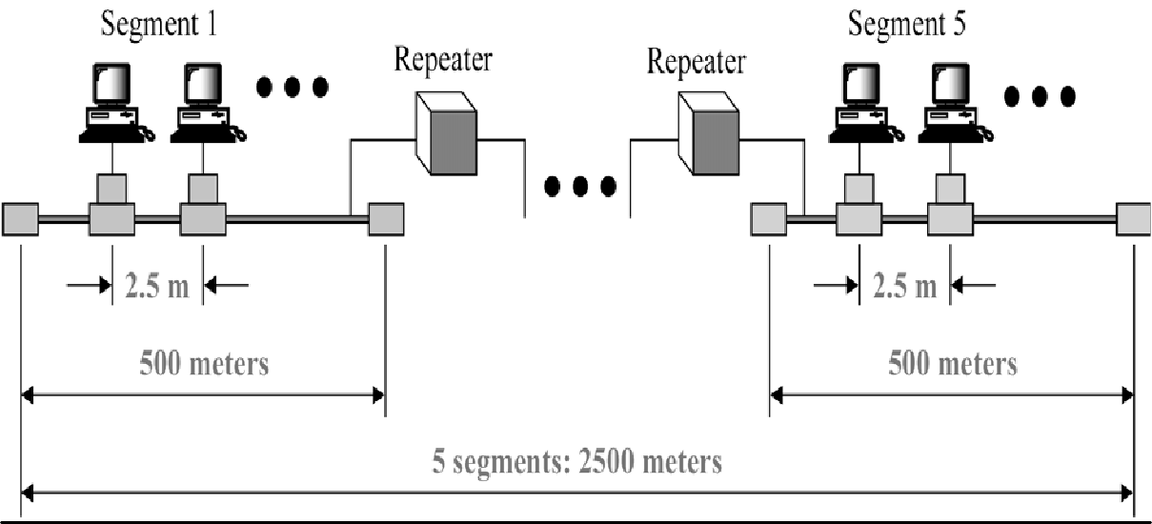
CS601-Data Communication
VU
Size Limitations of 10 Base 5
Networking devices such as Repeaters and Bridges are used to overcome the size limitation of LAN
In Thicknet, a LAN can be divided into segments by connecting devices
In this case, the length of each segment is limited to 500 meters
However to reduce collisions, the total length of the bus should not exceed 2500 meters (5 segments)
Also the standard demands that each station be separated from each other 2.5 meters
200 stations per segment and 1000 stations total
•
Topology of 10 Base 5
The physical connectors and cables utilized by 10 base 5 include coaxial cable, Network Interface Card, Transceivers and Attachment Unit Interface (AUI) cables

Slide 16
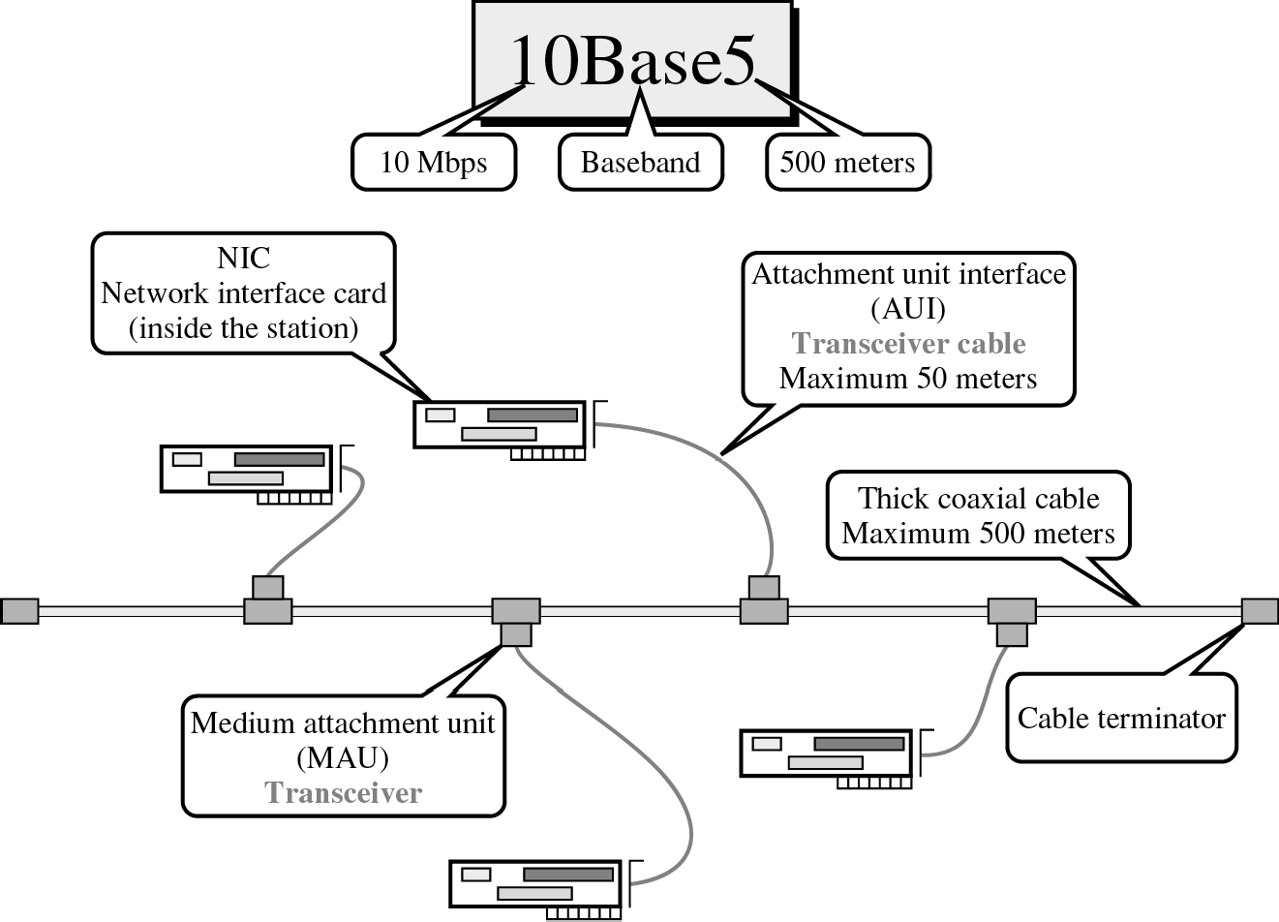
CS601-Data Communication
VU
RG-8 Cable
RG-8 cable (Radio Government) is a thick coaxial cable that provides the backbone of IEEE 802.3 standard
TRANSCEIVER
Each station is attached by an AUI cable to an intermediary device called a Medium Attachment Unit (MAU) or a Transceiver
Transceiver performs the CSMS/CD function of checking for voltages and collisions on the line and may contain a small buffer
AUI Cables
Each station is linked to its corresponding transceiver by an AUI cable also called the Transceiver cable
An AUI is a 15 wire cable with plug that performs the physical layer interface functions b/w the station and the transceiver
An AUI has a max. Length of 50 meters and it terminates in a 15-pin DB- 15 connector
TRANSCEIVER TAP
Each transceiver contains a connecting mechanism called a TAP because it allows the transceiver to tap into the line at any point
The TAP is a thick cable sized well with a metal spike in the center

Slide 17
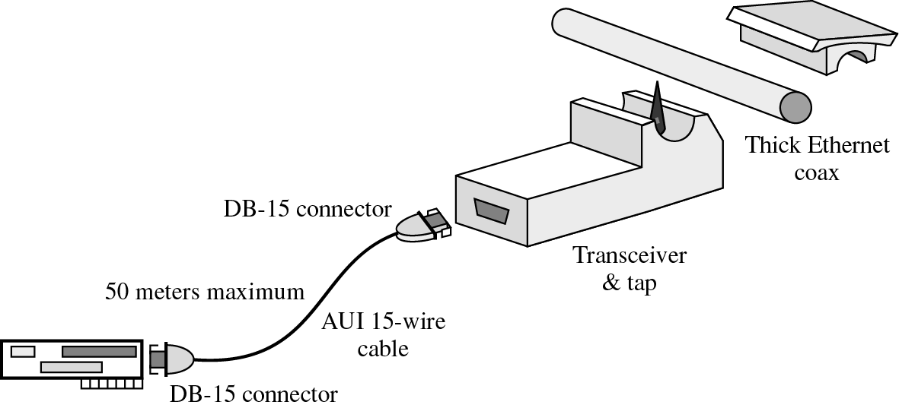
CS601-Data Communication
VU
The spike is attached to wires inside the transceiver
When the cable is pressed into the well, the spike pierces the jacket and sheathing layers and makes an electrical connection b/w the transceiver and the cables
This kind of connector is often called a VAMPIRE TAP because it bites the cable
Summary
*Local Area Networks (LANs)
*Project 802
*Protocol Data Unit (PDU)
*Ethernet
Reading Sections
*Section12.1, 12.2
“Data Communications and Networking” 4th Edition by Behrouz A. Forouzan

Slide 18
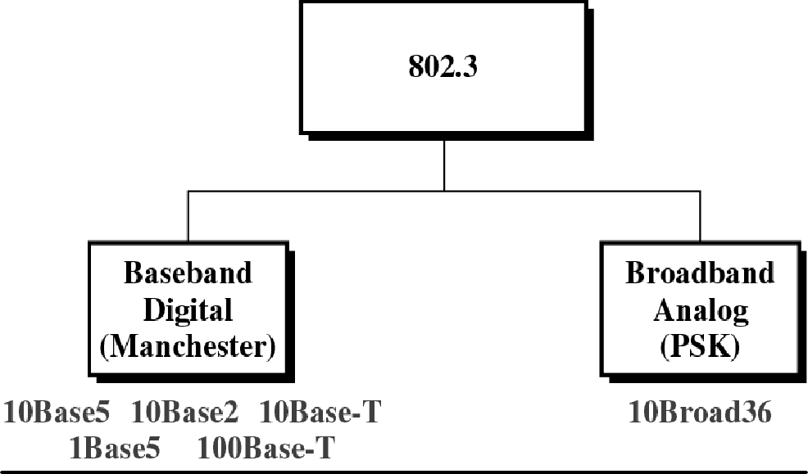
CS601-Data Communication
VU
LECTURE #43
Ethernet
10 Base 2: Thin Ethernet
The second Ethernet Implementation defined by IEEE 802 series is called 10 Base 2, Thin Ethernet, Thin net
Also called Cheap net because it provides an inexpensive alternative to 10 Base 5 Ethernet, with the same data rate
Like 10 Base 5, 10 Base 2 is a Bus Topology LAN
10 Base 2: Thin Ethernet
The advantages of thin Ethernet are :
–reduced cost and
–ease of installation
Because the cable is lighter weight and more flexible than that used in Thicknet
The disadvantages are:
–Short Range (185 m as opposed to 500 m)
–Smaller Capacity (thinner cable accommodates fewer stations)
Physical Topology of 10 base 2
The connectors and cables utilized are: NICs, Thin coaxial cable and BNC-T connectors
In this technology, the transceiver circuitry is moved to the NIC, and transceiver tap is replaced by connector that splices directly into the cable
No AUI cables are needed

Slide 19
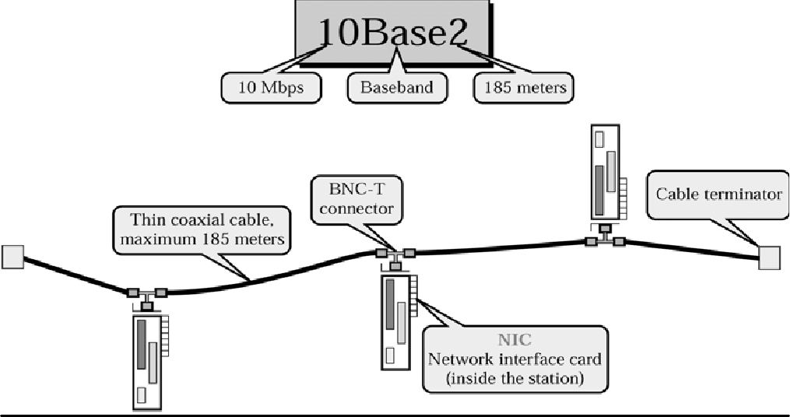
CS601-Data Communication
VU
NIC
NICs in Thin Ethernet provide the same functionality as those in Thicknet plus the functions of the Transceiver
A 10 Base 2 NIC not only provides the station with an address but also checks for voltages on the link
RG-58 Cable
These cables are relatively easy to install and move around
Especially inside the buildings where cable must be pulled through the walls and the ceilings
BNC-T
The BNC-T connector is a T-shaped device with three ports:
–One for the NIC
–One each for the input and output ends of the cable
10 base T: Twisted Pair Ethernet
Most popular standard defined in IEEE 802.3 series is 10 Base T also called Twisted Pair Ethernet
It is a Star topology LAN that uses Unshielded Twisted pair (UTP) cable instead of coaxial cable
It supports a data rate of 10 Mbps and has a maximum length of 100 meters

Slide 20
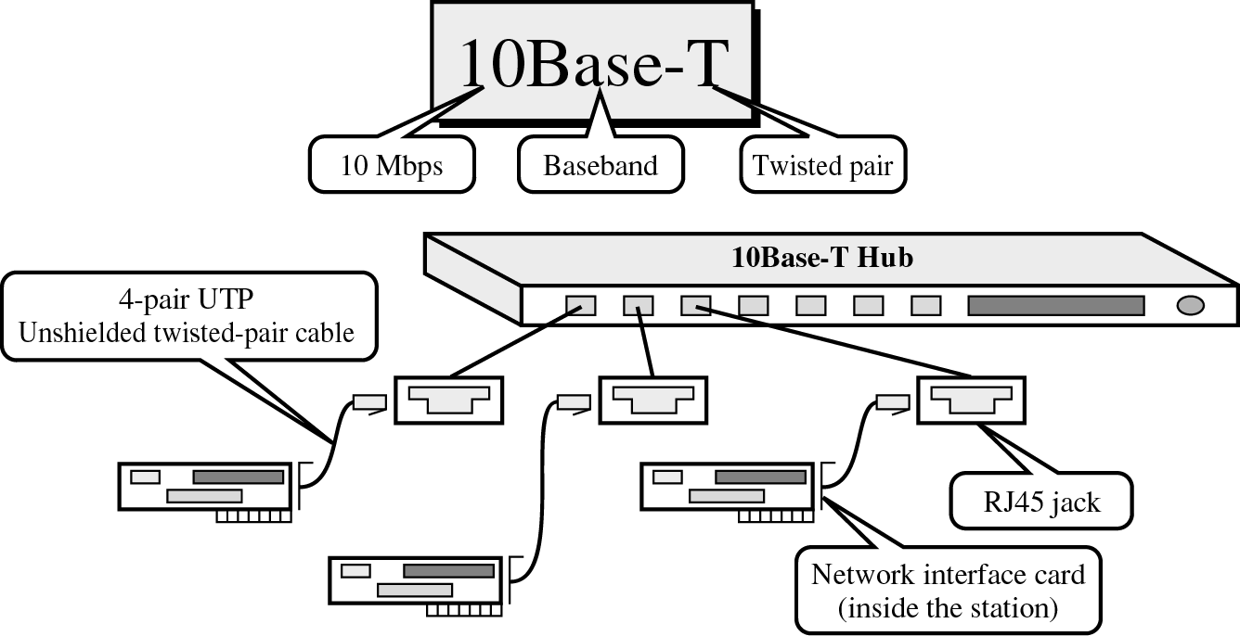
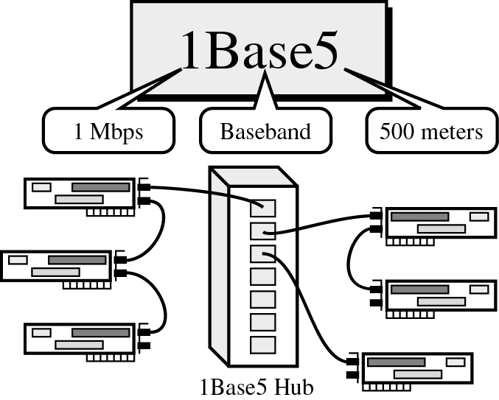
CS601-Data Communication
VU
Instead of individual transceivers, 10 Base T Ethernet places all of its networking operations in an intelligent Hub with a port for each station
Stations are linked into the hub by four pair RJ-45 cable terminating at each end in a male-type connector much like a Telephone jack
The hub fans out any transmitted frame to all of its connected stations
Each station contains a NIC
A 4-pair UTP of not more than 100 meters connects the NIC to the appropriate port in 10 Base T Hub
The weight & flexibility of the cable and the convenience of RJ-45 jack and plug makes it the easiest to install and reinstall
1 Base 5: STAR LAN
Star LAN is infrequently used nowadays because of its slow speed of approx. 1Mbps
Range can be increased by DAISY CHAINING
Like 10 Base T, Star LAN uses Twisted pair cable to connect stations to a central hub
Star LAN allows 10 devices to be linked with only the lead device connected to the hub
Switched Ethernet
An attempt to improve the performance of 10BASE-T
N ×10 Mbps with N devices

Slide 21
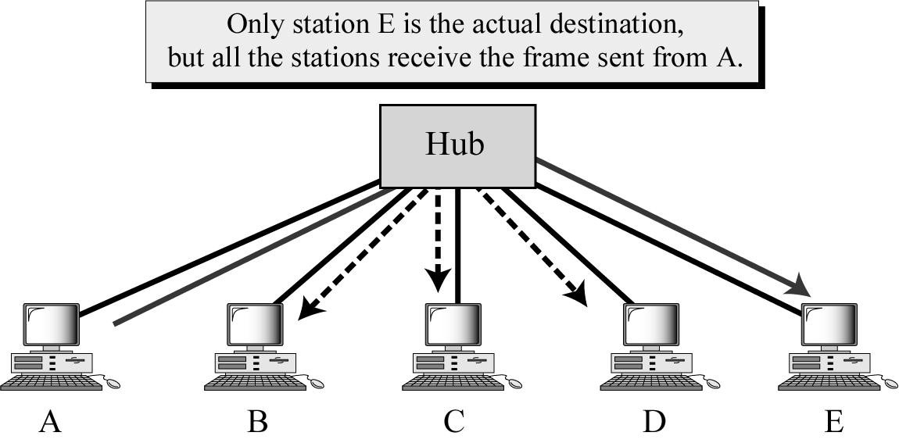
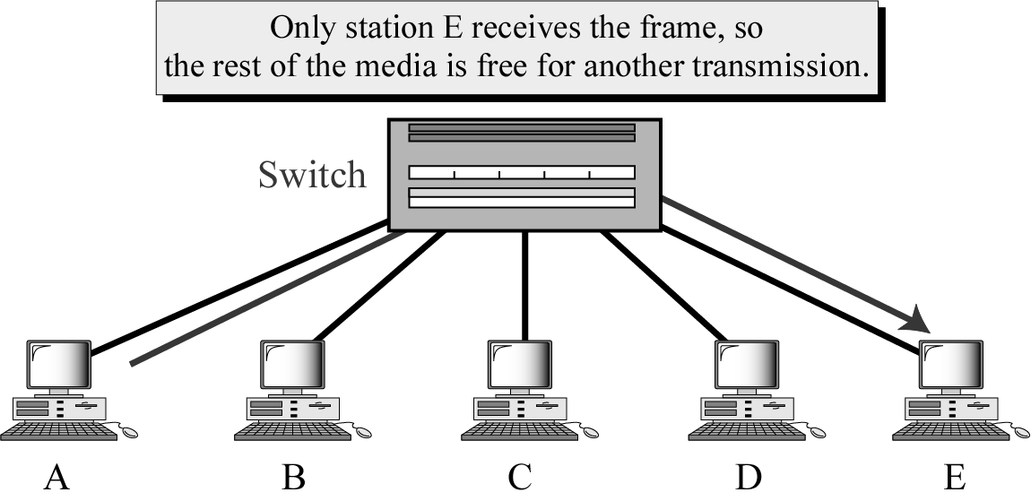
CS601-Data Communication
VU
Fast Ethernet
Data rate can be increased by decreasing the collision domain
If 10 Mbps ⇒ 100 Mbps, then
– 2500 m ⇒ 250 m
230

Slide 22
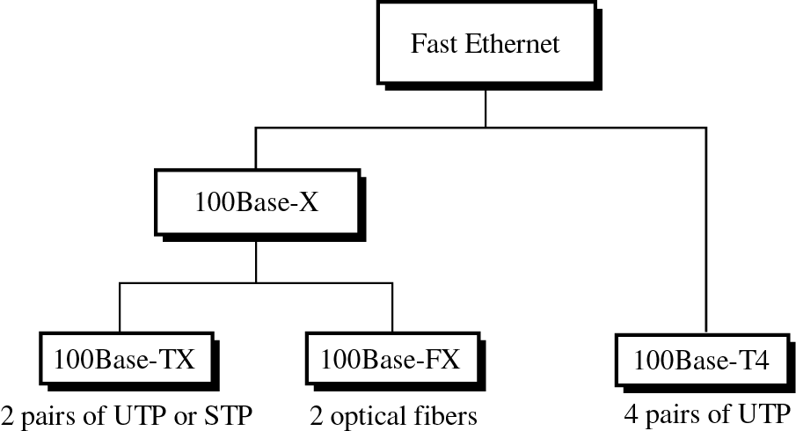
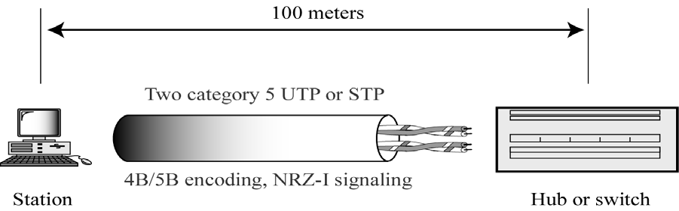
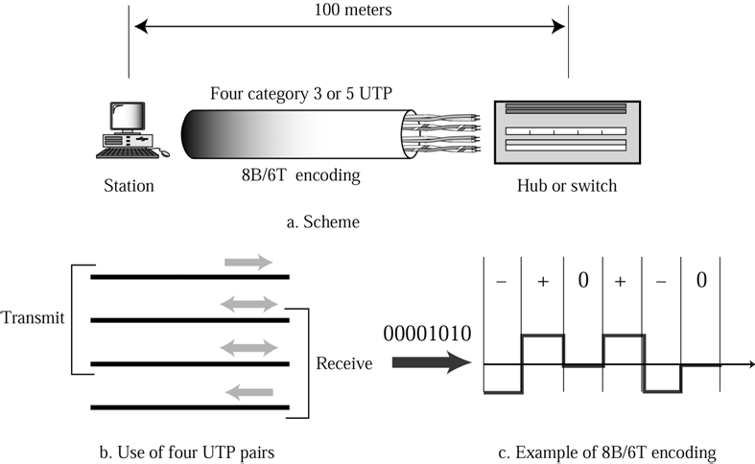
CS601-Data Communication
VU
100 Base-TX and 100 Base-FX
100 Base-T4

Slide 23
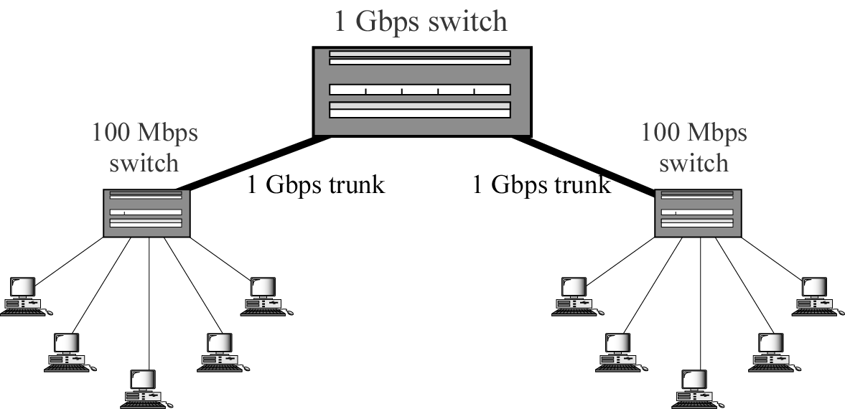
CS601-Data Communication
VU
Gigabit Ethernet
Usually serves as a backbone
Four implementations
–1000Base-SX, 1000Base-LX: Optical fiber, 550-5000 m
–1000Base-CX (STP), 1000Base-T (UTP): 25 m
Token Bus
Other LANs are not suitable for this purpose
Token Bus has no commercial application in data communications
Token Ring allows each station to send one frame per turn
Access method: Token passing
Summary
*Ethernet
–Implementations
*Other Ethernet Networks
*Token Bus/Ring
Reading Sections
*Section 12.2, 12.3, 12.4, 12.5
“Data Communications and Networking” 4th Edition by Behrouz A. Forouzan

Slide 24
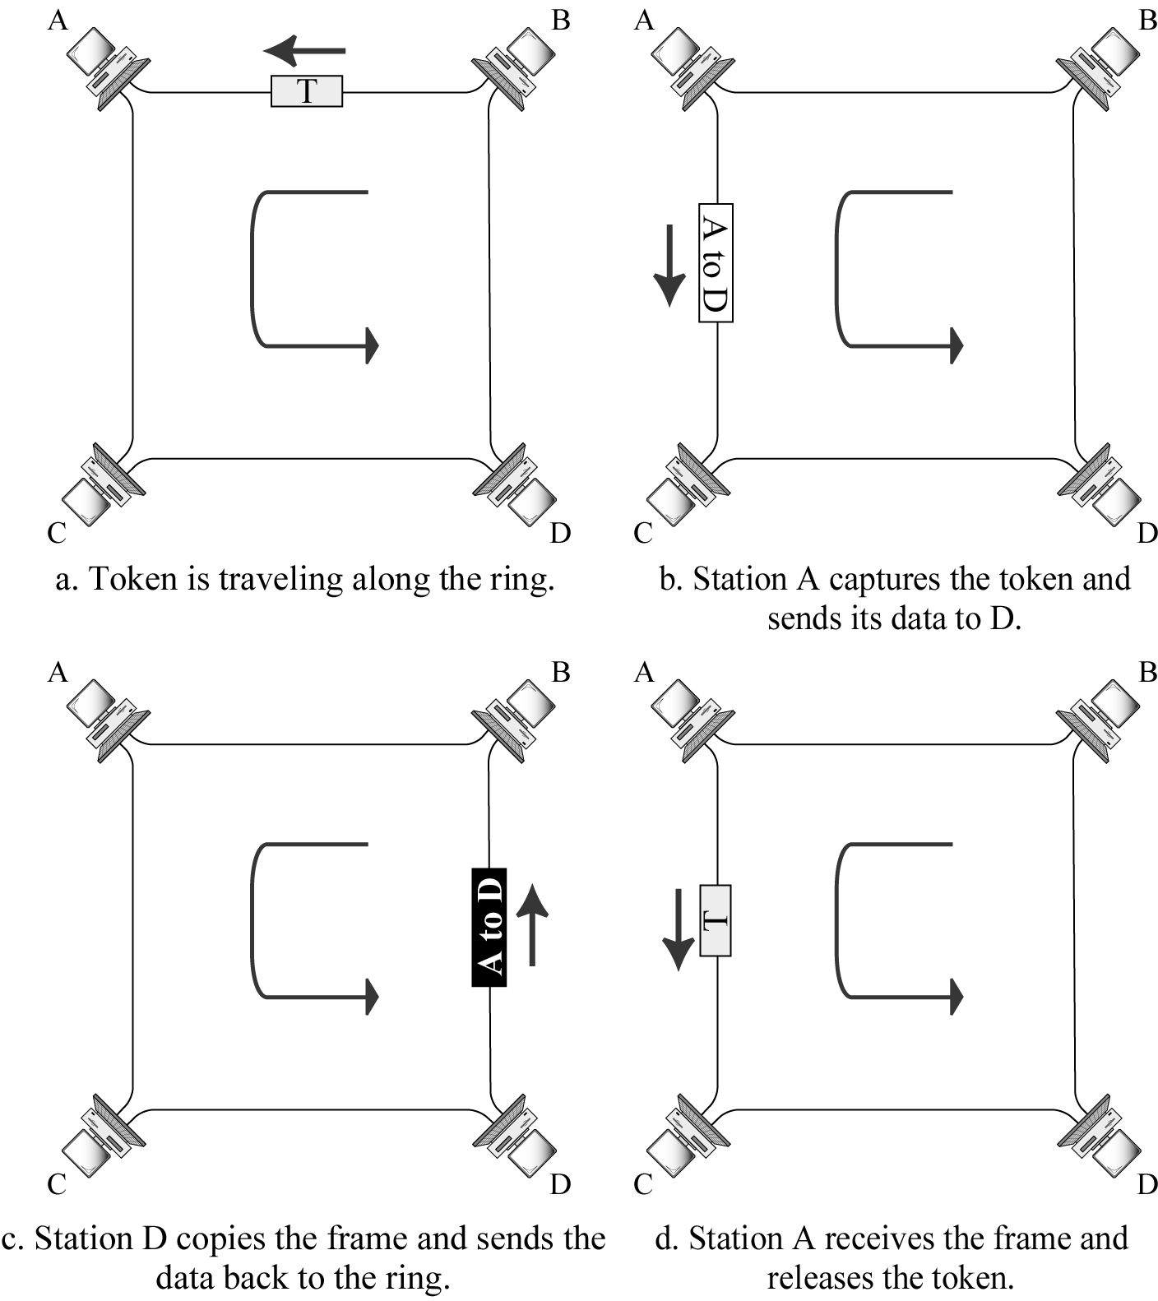
CS601-Data Communication
VU
LECTURE #44
Token Ring
Token Ring allows each station to send one frame per turn
Access method: Token passing
Access Control of Token Ring
Priority and reservation
–Each station has a priority code
Time limits
–Token Ring imposes a time limit to keep traffic moving
Monitor Stations
One station is designated as a monitor station to handle several problems
Monitor station generates a new token when it is lost
Monitor station removes recirculating data frames
Token Ring Frame

Slide 25
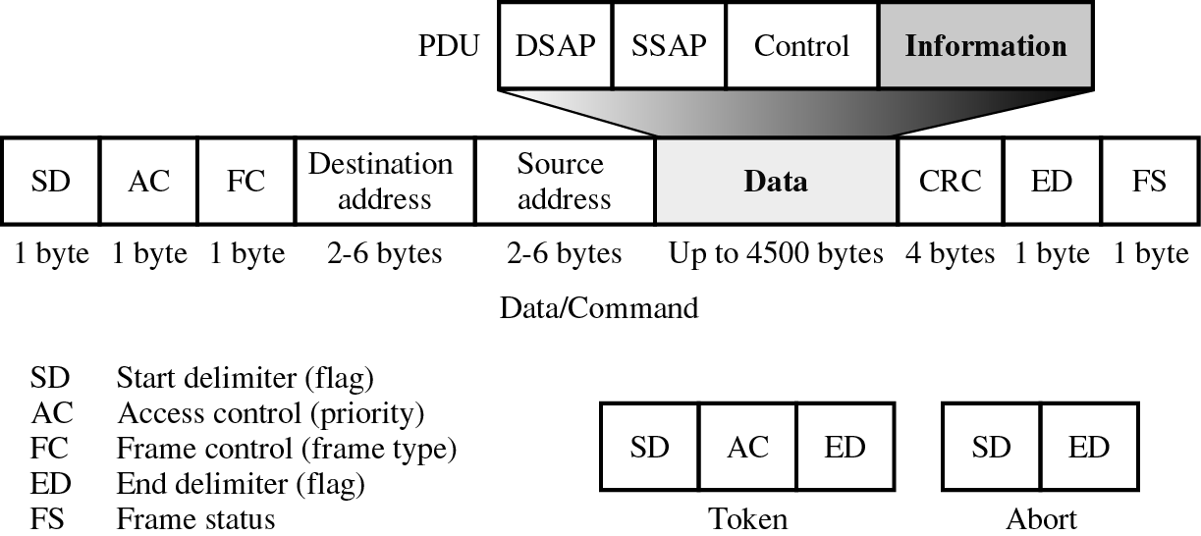
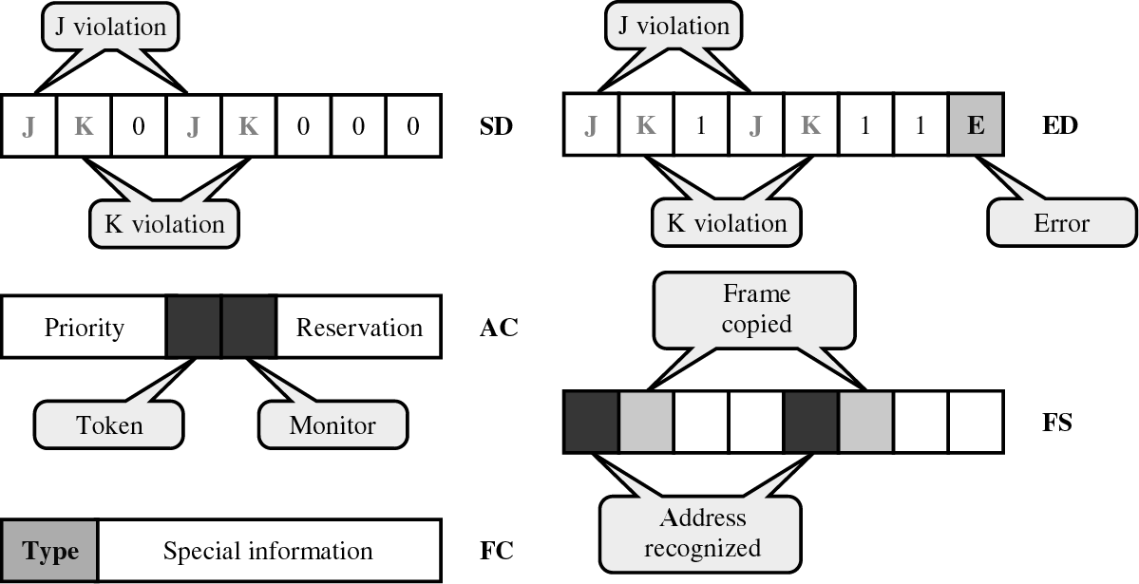
CS601-Data Communication
VU
Data Frame Fields
Implementation
Each station in the Token Ring regenerates the frame
One disabled or disconnected node could stop the traffic flow around the entire network
–Each station is connected to an automatic switch

Slide 26
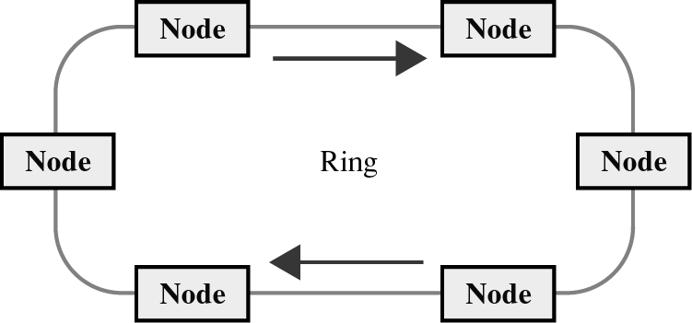
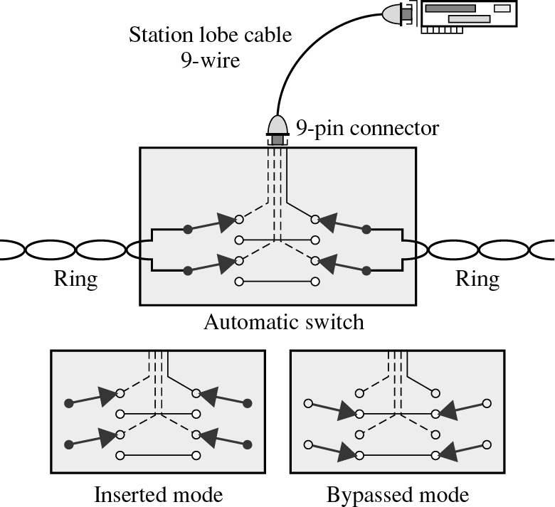
CS601-Data Communication
VU
Token Ring Switch
Multi station Access Unit (MAU)
Individual automatic switches are combined in to a hub
One MAU can support up to 8 stations
Although it looks like a star, it is in fact a ring

Slide 27
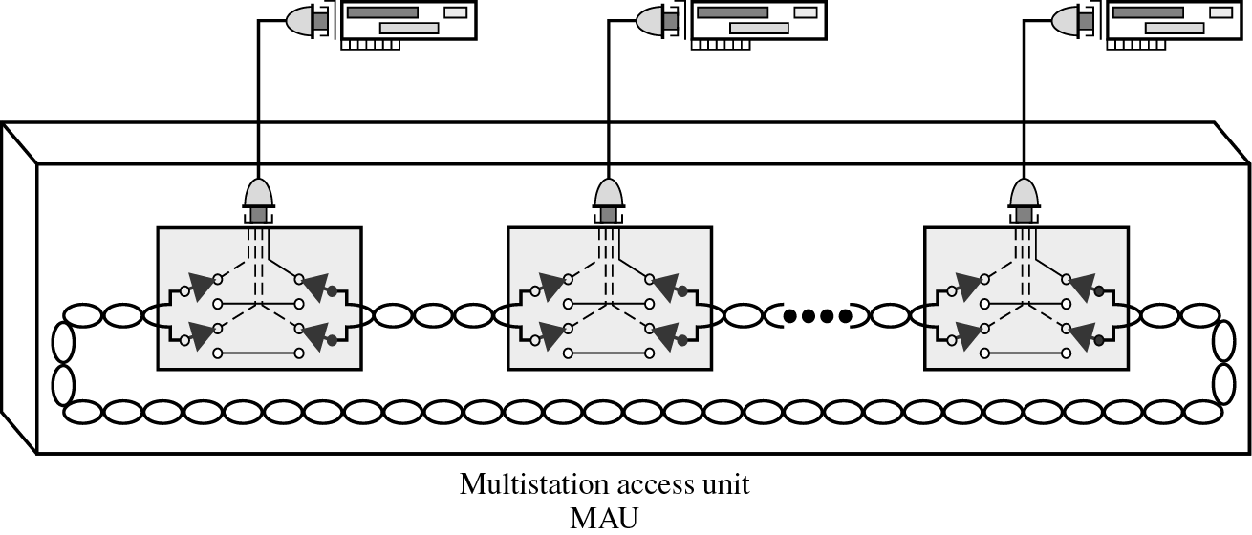
CS601-Data Communication
VU
FDDI
Fiber Distributed Data Interface standardized by ANSI and the ITU-T
100 Mbps LAN protocol
CDDI: Copper version of FDDI
Access method: Token passing
FDDI Time Registers
Time registers
–Values are set when the ring is initialized and do not vary
–SA (Synchronous Allocation)
–TTRT (Target Token Rotation Time)
–AMT (Absolute Maximum Time)
FDDI Timers
Timers
–Each station contains two timers
–TRT (Token Rotation Timer) : Incrementing
–THT (Token Holding Timer) : Decrementing

Slide 28
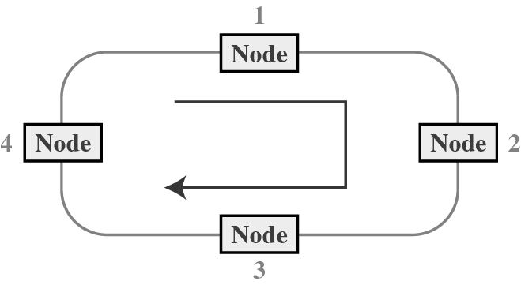
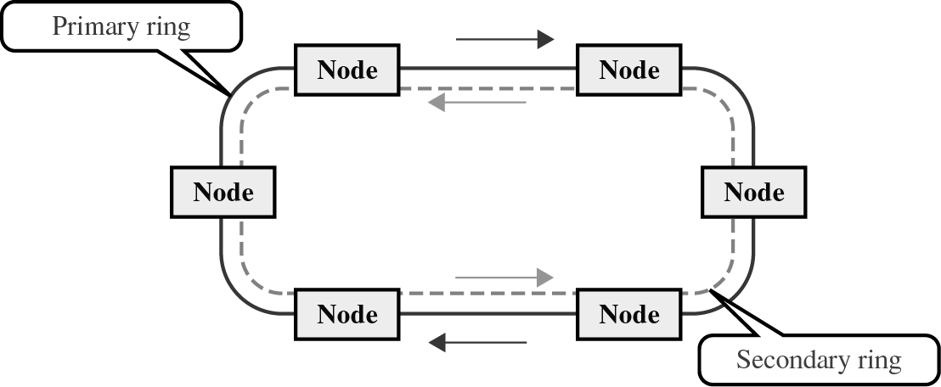
CS601-Data Communication
VU
Station Procedure
Station Procedure
THT is set to the difference between TTRT and TRT
THT = TTRT - TRT
TRT is reset to zero (TRT = 0)
The station sends S-frames during the time in SA
The station sends A-frames as long as THT ≥ 0
Release the token
Dual Ring (Figure-1)

Slide 29
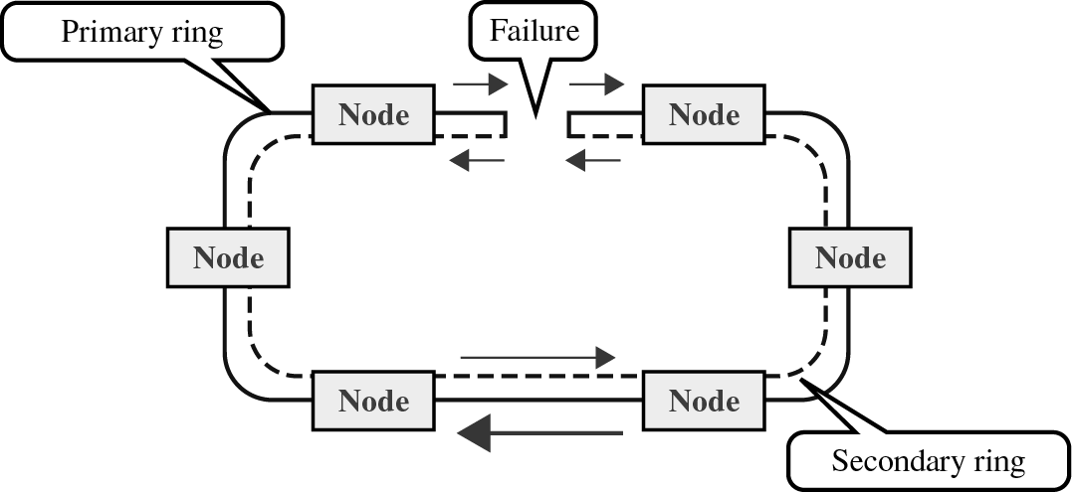
CS601-Data Communication
VU
Dual Ring (Figure-2)
Summary
*Token Ring
*FDDI
Reading Sections
*Section 12.5, 12.6, 12.7
“Data Communications and Networking” 4th Edition by Behrouz A. Forouzan

Slide 30
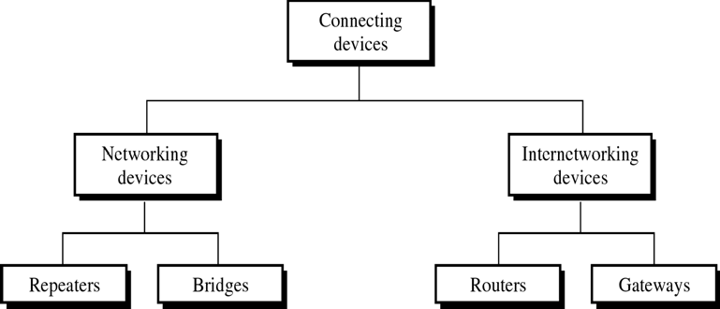
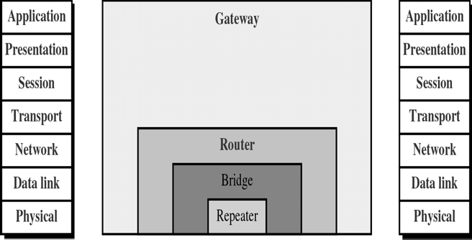
CS601-Data Communication
VU
LECTURE #45
Internet
An internet is a generic term used to mean an interconnection of individual networks
To create an internet, we need networking devices called routers and gateways
An internet is different from the Internet
Internet is the name of a specific worldwide network
Connecting devices (Figure-1)
Connecting devices (Figure-2)

Slide 31
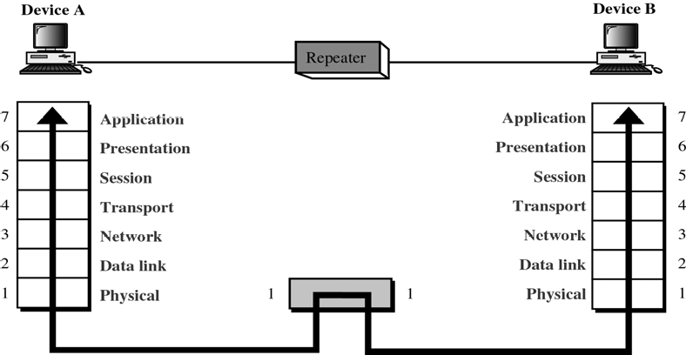
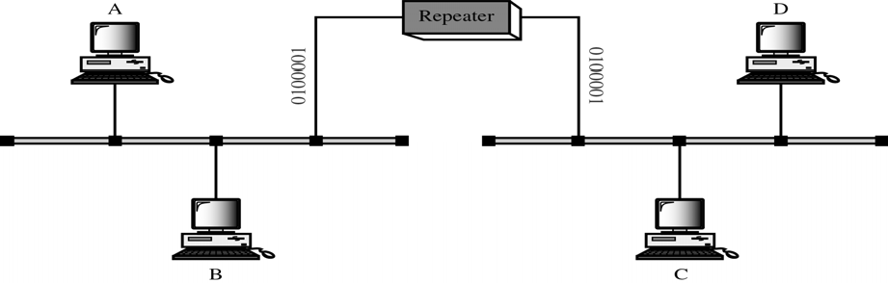
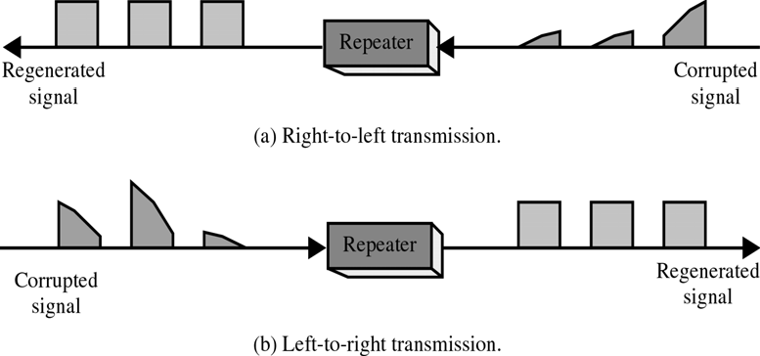
CS601-Data Communication
VU
Repeaters
Repeaters (Figure-1)
A repeater allows us to extend only the physical length of a network
Repeater is a regenerator, not an amplifier
Repeaters (Figure-2)
Repeaters (Figure-3)
240

Slide 32
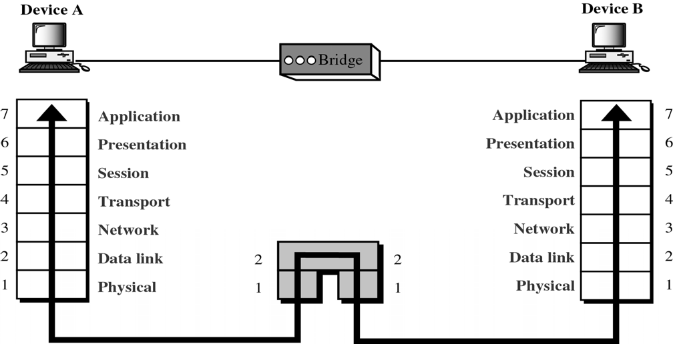
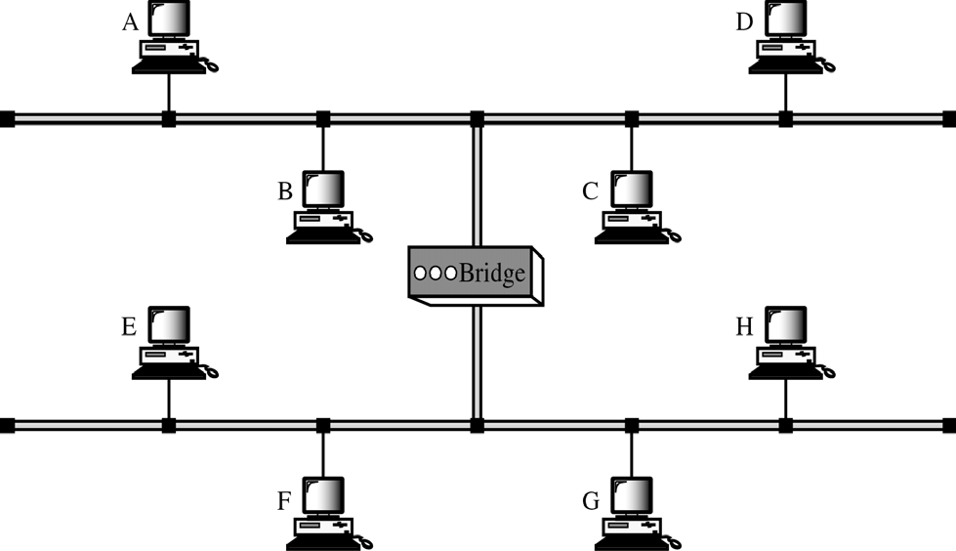
CS601-Data Communication
VU
Bridges
o Bridges can divide a large network into smaller segments
When a frame enters a bridge, the bridge:

Slide 33
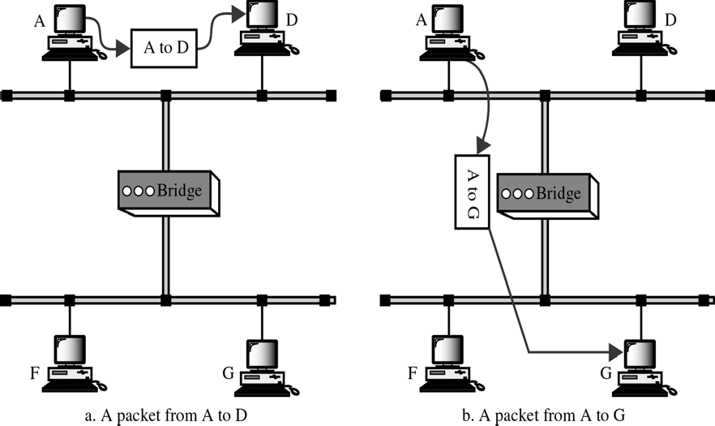
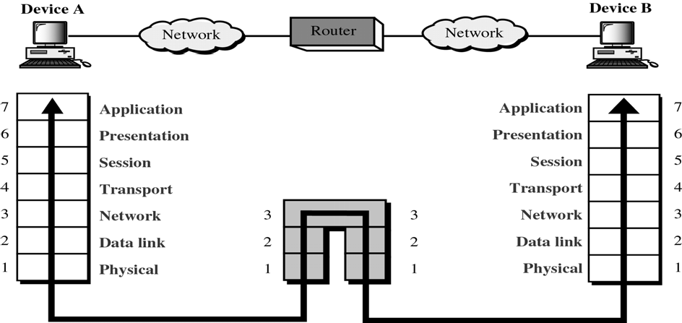
CS601-Data Communication
VU
–not only regenerates the signal
–but check the address of the destination and forwards the new copy only to the segment to which the address belongs
Routers
Routers relay packets among multiple interconnection networks

Slide 34
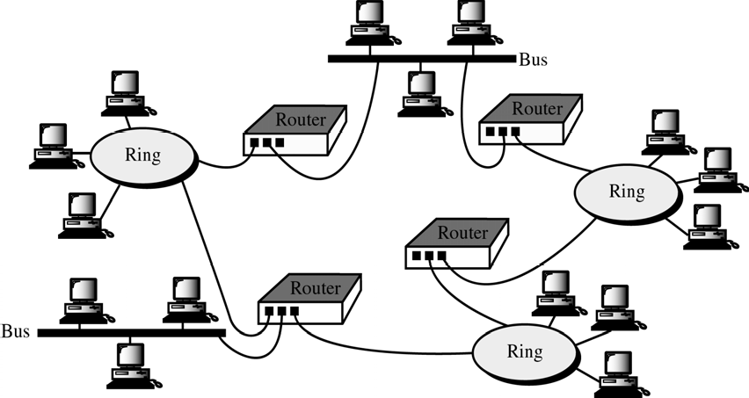

CS601-Data Communication
VU
TCP/IP
Transmission Control Protocol/ Internet Protocol
o 1969
ARPA(Advanced Research Project Agency) net

Slide 35

CS601-Data Communication
VU
TCP/IP and OSI
TCP/IP Protocols
Network Layer
–IP (Internetworking Protocol )
–ARP(Address Resolution Protocol)
–RARP(Reverse Address Resolution Protocol)
–ICMP(Internet Control Message Protocol)
–IGMP(Internet Group Message Protocol)
Transport Layer
–TCP (Transmission Control Protocol)
–UDP (User Datagram Protocol)
Summary
*Internet work
*Connecting Devices
–Repeaters
–Bridges
–Routers
*TCP/IP Protocol Suite
Reading Sections
*Section 21.1, 21.2, 21.3, 24.1, 24.2,
“Data Communications and Networking” 4th Edition by Behrouz A. Forouzan

